Slide 1

Adaptive ECG-Based Biometric Authentication
Université Catholique de Lille
Using a Wearable Device and Cloud Database
Michel Rizkallah
M2 Cyber

Slide 2
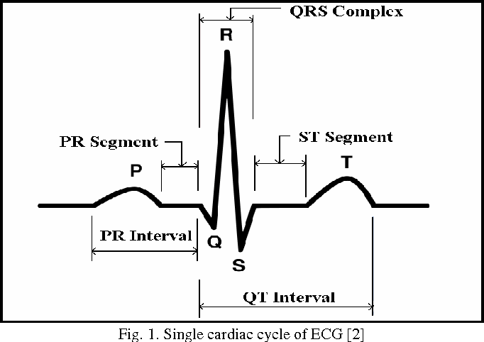
Context & Problem
Traditional authentication (passwords, PINs) is vulnerable to attacks
Biometrics offer stronger identity verification
ECG signals are internal physiological biometrics, difficult to spoof
Existing CNN-based ECG authentication systems still face limitations in performance, complexity
Need strong systems to physiological drift and multi-session variability

Slide 3
Research Objectives & Challenges
Performance of ECG authentication systems decreases over time due to:
Existing CNN-based approaches also show limited performance on wearable ECG data
Intra-individual variability
Physiological drift
Non‑ideal wearable acquisition conditions
Research Question:
How can ECG-based biometric authentication be improved beyond CNN models while maintaining reliability despite long-term physiological changes?

Slide 4
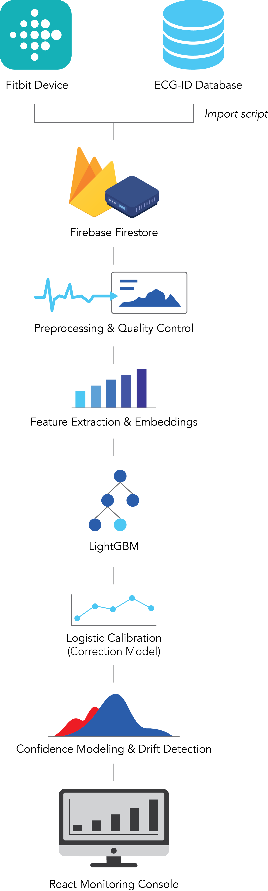
System Architecture
Data Sources:
ECG-ID Dataset (PhysioNet benchmark)
Fitbit Charge 6 wearable ECG
Pipeline:
Import → Preprocessing → Feature Extraction → ML Model → Monitoring

Slide 5

Frontend Tech (UI)
Framework: React 19 + TypeScript
Build tool: Vite 7
State & Data fetching: TanStack React Query + Axios
Charts/Visualization: Recharts
Utility libs: clsx, date-fns
Code quality: ESLint + TypeScript strict mode
Main UI modules: Enrollment Wizard, Verification Panel, Analytics Tab, Continuous Monitor, Participants Tab

Slide 6

Backend Tech (FitServer)
Platform: ASP.NET Core Web API (.NET 9)
Architecture: Controllers + Services + Middleware + Hosted background services
Auth/Integration: Fitbit OAuth middleware (FitbitAuthMiddleware)
Data layer: Google Firestore (Google.Cloud.Firestore)
Cloud/Admin: Firebase Admin SDK
ML stack: ML.NET (Microsoft.ML, FastTree, LightGBM) + ONNX Runtime + MathNet.Numerics
API docs: Swagger / OpenAPI
Core capabilities: ECG enrollment, training, verification, continuous verification, adaptive retraining

Slide 7


Tests (Frontend + Backend)
Frontend Unit tests: Vitest + Testing Library (npm run test:unit)
Frontend E2E tests: Playwright (npm run test:e2e)
Frontend extra quality: accessibility checks (@axe-core/playwright) + visual regression snapshots
Backend tests: xUnit + Microsoft.AspNetCore.Mvc.Testing + WebApplicationFactory
Backend coverage: Coverlet (Cobertura report)
Backend command: dotnet test Tests/FitServer.Tests/FitServer.Tests.csproj
Test scope: unit tests (signal processing/ML rules/services) + integration tests (controllers/endpoints + auth/error/happy paths)

Slide 8
Acquisition:
Feature Extraction
Mean, RMS, variance
RR interval, QRS duration
Spectral entropy
Embedding distances (L2, cosine)
ECG-ID dataset (90 subjects, 310 sessions)
Fitbit ECG recordings (~30 seconds)
Methodology

Slide 9
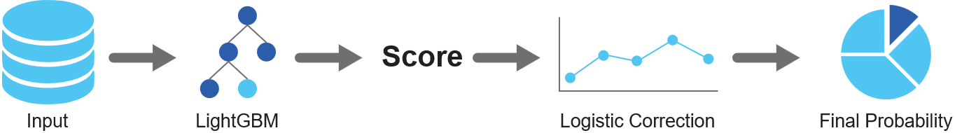
Machine Learning Architecture
Two‑Stage Model:
LightGBM classifier
64 leaves
500 iterations
Learning rate 0.05
Logistic Calibration Layer
Adjusts probability
Integrates signal quality

Slide 10
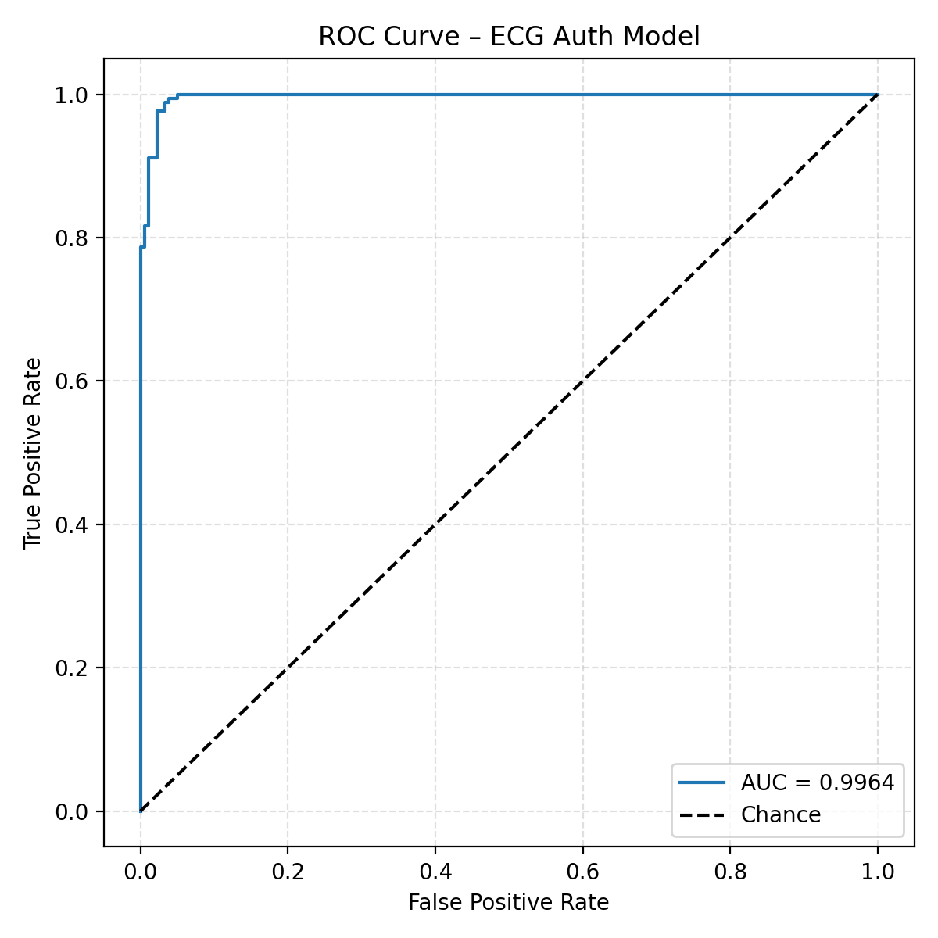
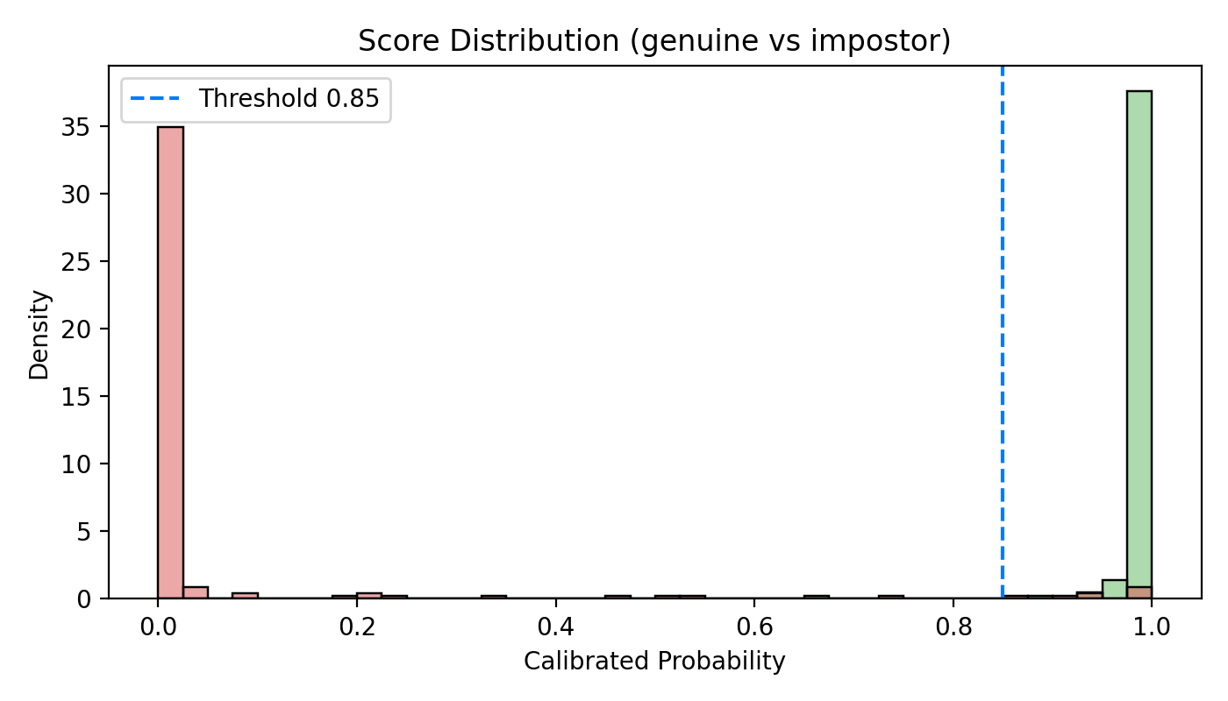
Results (ECG-ID Benchmark)
Dataset:
90 subjects
310 sessions
60/40 train-test split
Performance:
Accuracy ≈ 0.93
F1-score ≈ 0.934
ROC AUC ≈ 0.996

Slide 11
ECG-ID Dataset Comparison:
Safie et al. 2024 (CNN)
AUC ≈ 0.84
Proposed Method
AUC ≈ 0.996
Improvement due to pairwise verification, feature engineering, and calibration
Comparison with Literature

Slide 12
Adaptive Mechanism
System includes:
Continuous score monitoring
Drift detection
Automatic retraining
Long-term confidence modeling
Ensures stable authentication over time

Slide 13
Conclusion
ECG signals provide a highly discriminative biometric modality
Benchmark evaluation on ECG-ID shows strong performance (AUC ≈ 0.996)
Framework extended to Fitbit wearable ECG
Adaptive retraining enables long-term biometric authentication

